Slide 1


MICRENs – Next Generation Energy Storage
Graphene Planar micro Supercapacitors for low volume, high energy applications

Slide 2


Who is Ionic?
A collaboration-based, technology platform delivering a consistent flow of advanced materials technology from lab to market, addressing the world’s biggest problems
Early stage research and identification of potential applications
Technology validation, application feasibility and product development
Product deployment with commercialisation partners or marketing and sales
Ionic with Commercialisation Partners
Joint Venture Company
Licenced technology
Revenues
Building on our partnerships and technology over 7 years and $3.4 million in R&D funding, Ionic is amongst the first companies working on commercially viable applications of graphene technologies
Collaboration model reduces technology validation risks and accelerates paths to market, thereby reducing uncertainty and business risks
Portfolio approach to technologies and applications mitigates the risk of reliance on a single technology and expands market potential

Slide 3
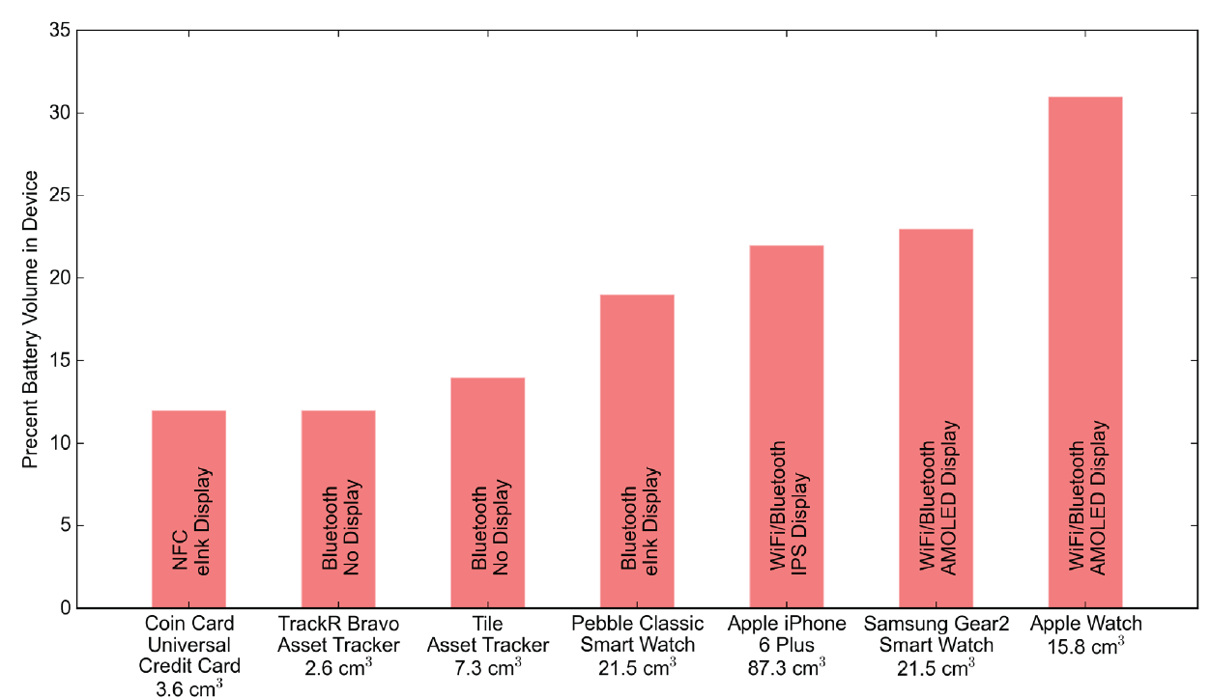
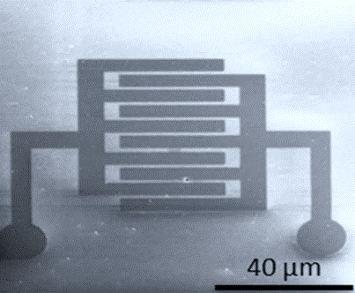
Ionic Industries MICRENs
Energy storage technologies are one of the greatest constraints in the development of many new technologies.
Small portable electronic devices have steadily evolved toward compact and thin form factors and batteries have become an ever-increasing fraction of the total device volume.
https://issuu.com/ecs1902/docs/2016-if-spr-web-issuu
Requirements to both store energy AND discharge / recharge at a rapid rate are holding back applications in a wide range of fields from consumer electronics, medical and health devices and IoT markets.
MICRENs devices represent next generation energy storage technology – supercapacitors with as much energy as lithium ion batteries.

Slide 4
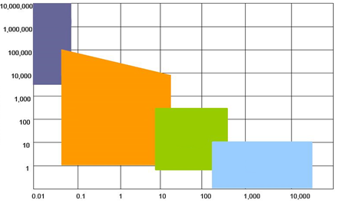
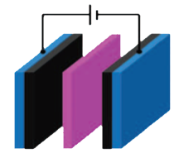
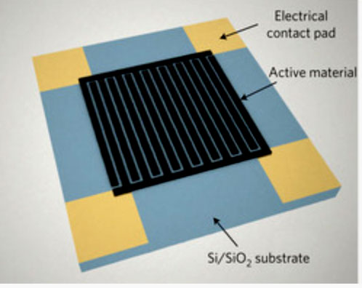
Why Supercapacitors?
Specific power
http://www.cap-xx.com/resource/energy-storage-technologies/
Capacitors
Offer balance in energy and power requirements in portable electronics
High charge / discharge efficiency
Green technology
Minimal maintenance
Supercapacitors
Batteries
Fuel Cells
Specific Energy
Planar supercapacitors have a number of advantages over conventional 3D supercapacitors
Control and shorten the distance ions travel between the two electrodes
Easily integrated into devices
Potentially the architecture can be extended in 3D without losing the inter-electrode distance
El Kady et al, Science, 2012, 335, 1326-1330
Pech et al, Nature Nanotechnology, 2010, 5, 651-654

Slide 5
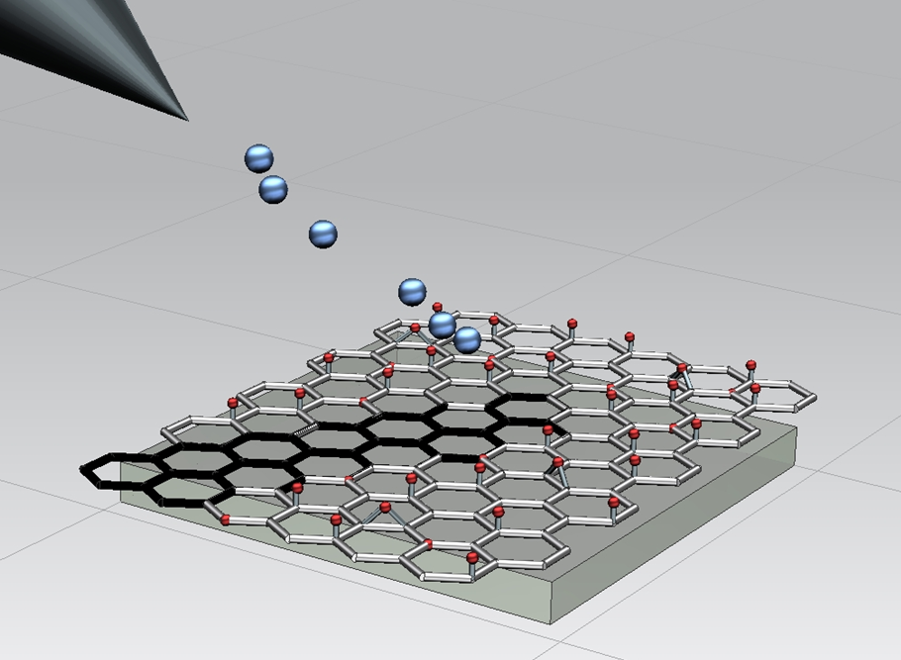
Our approach
Ga ions bombard GO with excess momentum
C-C bonds are stronger than C-O
Higher probability of breaking C-O bonds
Oxygen is sputtered away
Lobo et al, Langmuir, 2012, 28, 14815-14821

Slide 6
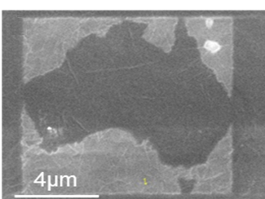
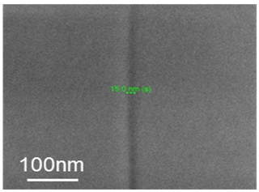
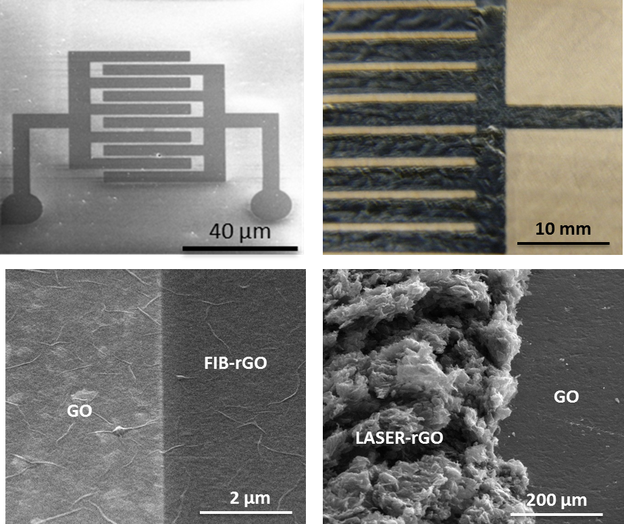
Advantages of our approach
Fast direct-write method, Fine feature control, Minimal damage of GO sheets
Lobo et al, Langmuir, 2012, 28, 14815-14821
Majumder et al, US9558887B2 (grant)

Slide 7
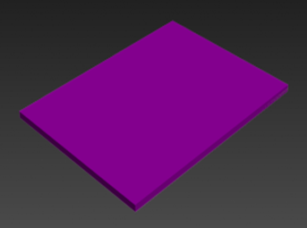
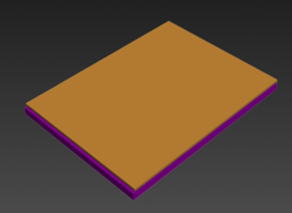
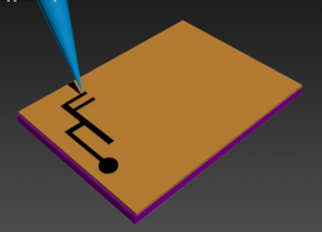
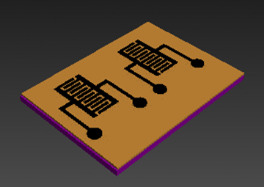
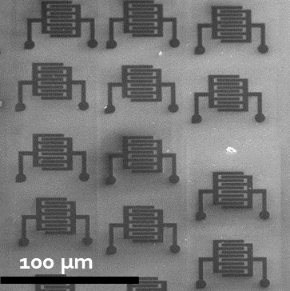
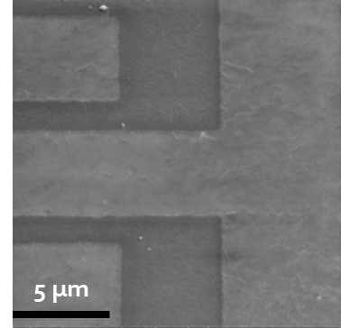
Fabrication of the FIB rGO electrodes
Fabrication of the FIB electrodes is a simple, 3-step process.

Slide 8
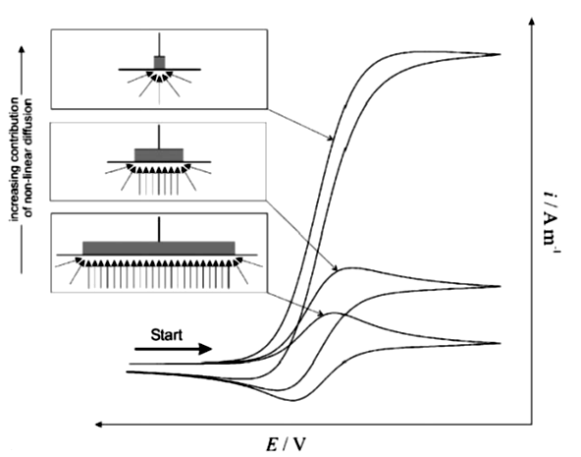

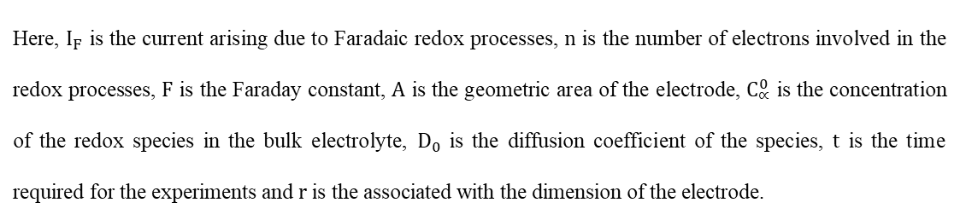

Why Miniaturize?
Miniaturization ➔ Enhanced electrochemical response
$$I_{F}=nFAC_{∝}^{0}{\left(\frac{D_{0}}{πt}\right)}^{\frac{1}{2}}$$
For microelectrodes,
$$I_{F}=nFAC_{∝}^{0}{\left(\frac{D_{0}}{πt}\right)}^{\frac{1}{2}}+nFAD_{0}\frac{C_{∝}^{0}}{r}$$
F. Marken, A. Neudeck, A. M Bond, Electroanalytical Methods (Ed. F. Scholz), Springer, 2010
Here, $I_{F}$ is the current arising due to Faradaic redox processes, $n$ is the number of electrons involved in the redox processes, $F$ is the Faraday constant, $A$ is the geometric area of the electrode, $C_{∝}^{0}$ is the concentration of the redox species in the bulk electrolyte, $D_{0}$ is the diffusion coefficient of the species, $t$ is the time required for the experiments and $r$ is the associated with the dimension of the electrode.

Slide 9
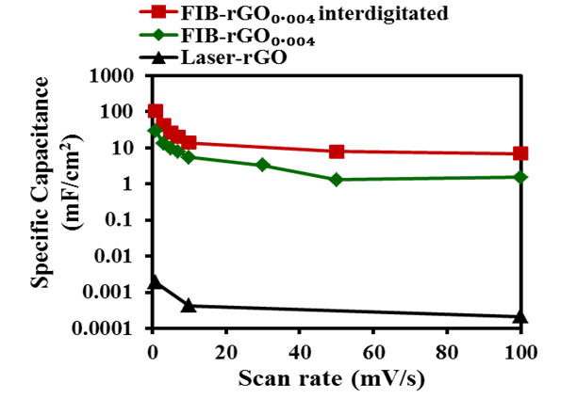
Capacitance vs Scan Rate
At small scan rates (<10 mV), specific capacitance has strong dependence with scan rate
At large scan rates (>10 mV), specific capacitance has weak dependence with scan rate
Banerjee et al, Advanced Energy Materials, 2015, 1500665

Slide 10
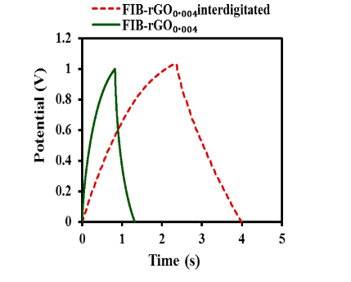
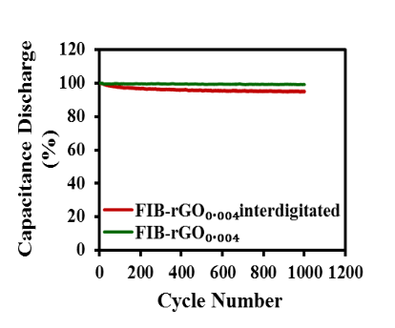
Influence of Miniaturization: GCPL
Banerjee et al, Advanced Energy Materials, 2015, 1500665
Specific capacitance ➔ 104 mF/cm2
iR drop ➔ 0.02 V for the interdigitated even at an ultrahigh current density of 45 mA/cm2
At least 95 % specific capacitance retention capability after 1000 cycles

Slide 11
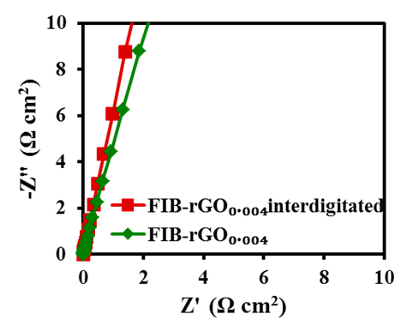
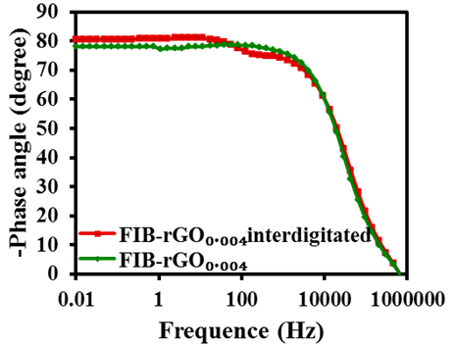
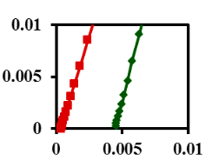
Influence of Miniaturization: EIS
Ultra-low ESR, Ultra-fast response, and Large frequency range of operation
Banerjee et al, Advanced Energy Materials, 2015, 1500665
Equivalent series resistance of the interdigitated electrode ➔ 0.35 mΩ cm2
Dominant capacitive behaviour at frequencies as high as 100 kHz
Response time of the interdigitated electrode ➔ 0.033 ms

Slide 12
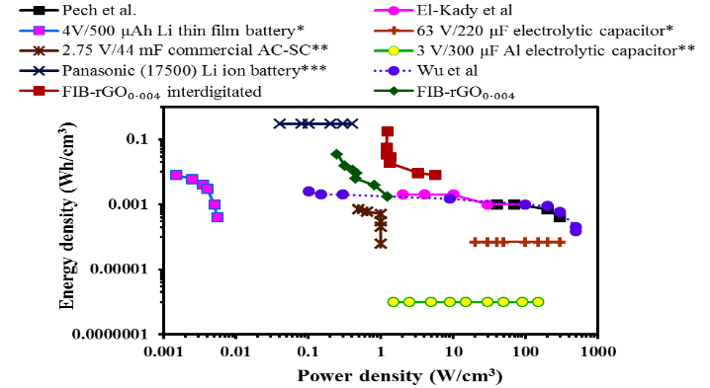
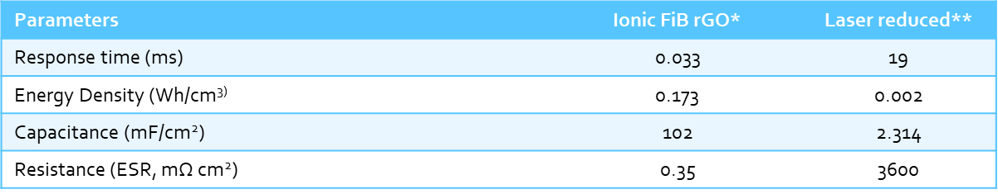
Ragone plot
Banerjee et al, Advanced Energy Materials, 2015, 1500665
*Banerjee et al, Advanced Energy Materials, 2015, 1500665
**El Kady et al., Nature communications, 2013, 4, 1475

Slide 13

Manufacturing MICRENs with Printing
Our patent pending, rapid printing process for manufacturing MICRENS will contribute to scalability and cost advantages

Slide 14
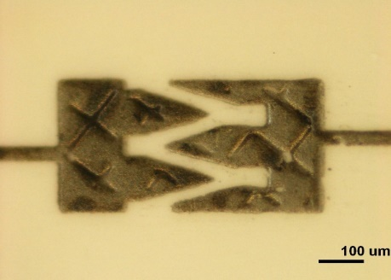
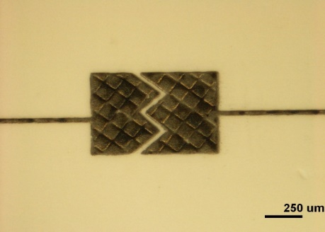
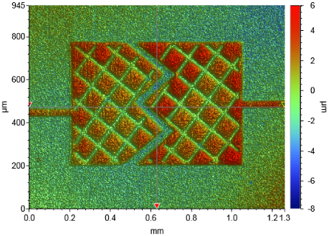
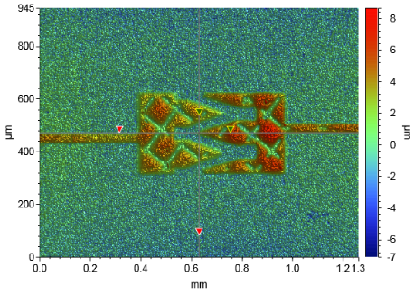
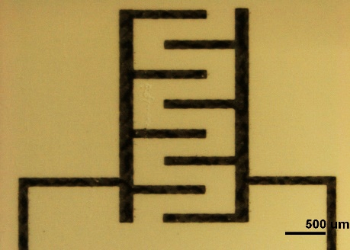
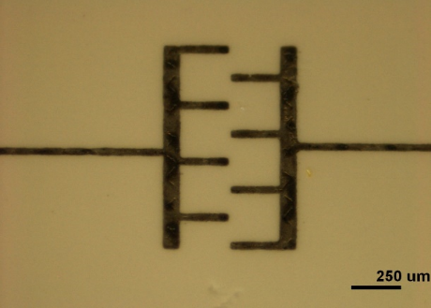
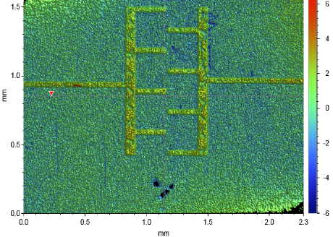
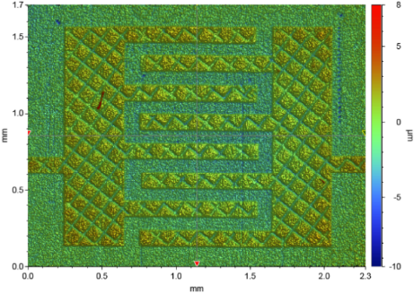
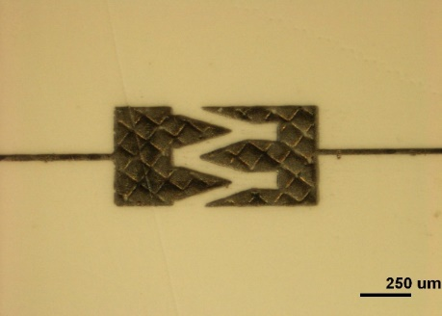
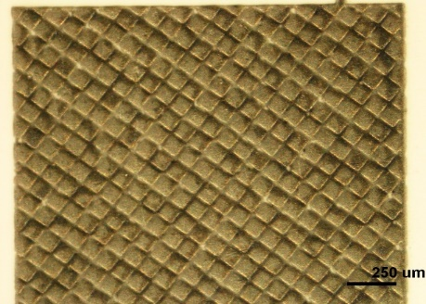
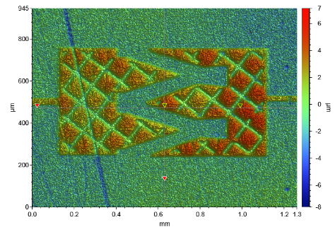
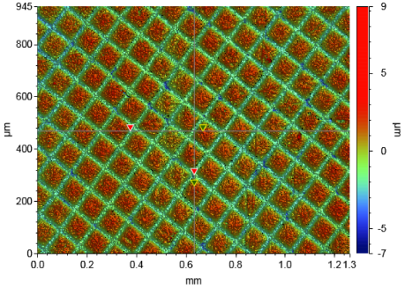
Our Research
All-carbon electrode, inter-electrode distance < 50 µm, feature size 50-100 µm,

Slide 15
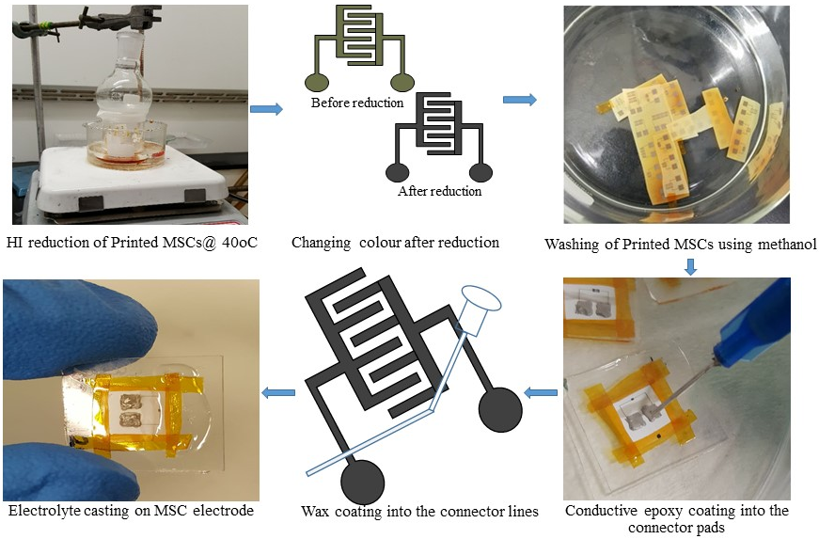
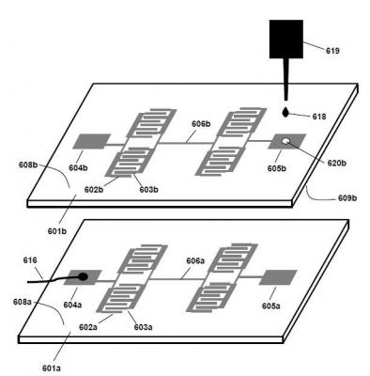
Printed Micrens using gravure printer
Fabrication steps of printed MSCs
Stacking of printed MSCs

Slide 16
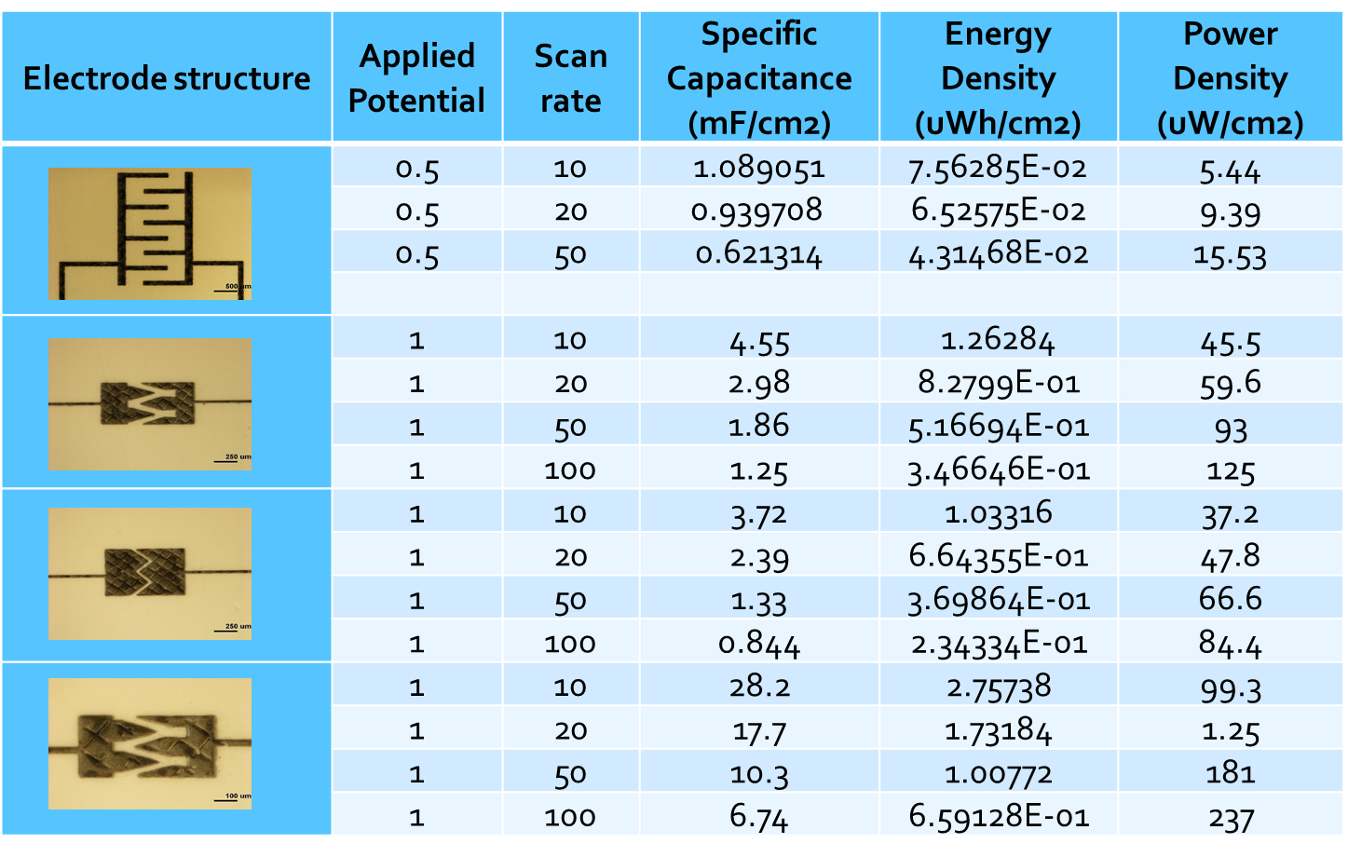
Research outcome
The outcomes from our research show that in printed MICRENns with ~ 30 µm interelectrode distance non-linear scaling of specific capacitance is observed.

Slide 17
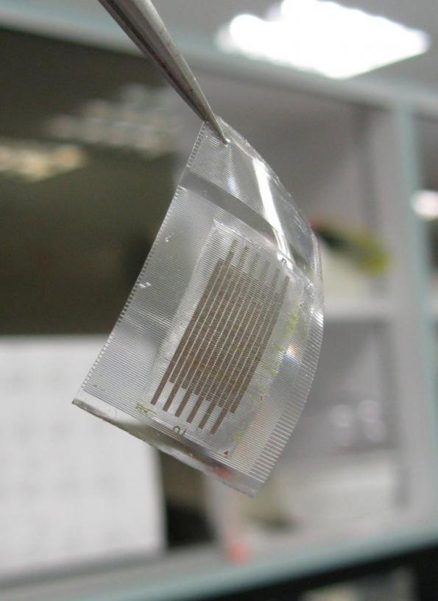
Technical Challenges Remaining
Finer and higher resolution printing (~20-30 micron features) for obtaining energy density enhancements by non-linear diffusion
Irradiation based, chemical-free Graphene Oxide reduction technology
Electrolyte printing technology for increasing the voltage window
Overprinting of electrolyte on electrode (& vice versa) for decreasing dead-volume
Tuning device property to target applications
Example of potential MICRENs form factor Image Courtesy: Nanyang Technological University

Slide 18
The Target Performance
We have several generations of this technology planned and will explore potential commercial applications for each generation.
2018
2019 1st Gen
2019 2nd Gen
Commercial prototype comparable to activated carbon supercapacitor (2.75 V/44 mF), with energy ~0.6 mWh/cm³ and power ~0.3 W/cm³
Potential commercial applications
3D stacked device with consistent defect free printing
Better than existing supercapacitors 14 mF/cm3, 0.04 mWh/cm3, 1.5 mW/cm3
High conductivity and reduced leakage current
2020 3rd Gen
Printed supercapacitor electrodes with energy and power like a 4 V/500 μAh thin film Li-ion battery (2mWh/cm³ and 0.3 W/cm³)
Safe, cheap materials – aqueous electrolyte etc
Interdigitated devices printed at feature size <100µm, thickness of device ~50nm
Proof of concept for 3D stacked, printed devices and patent filing
Begin exploring potential commercial applications
Timeframes may be varied depending on funding and market drivers.

Slide 19
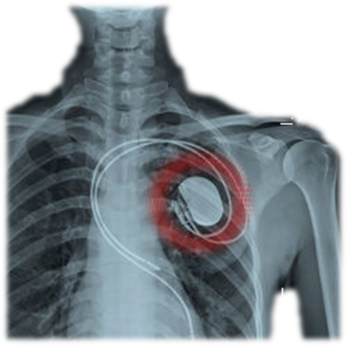


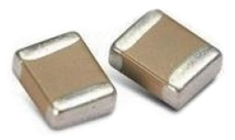
Applications
On-chip capacitors (µF-mF range) with variable voltage
Implantable medical devices
Wearables
IoT devices
Quantum capacitors

Slide 20
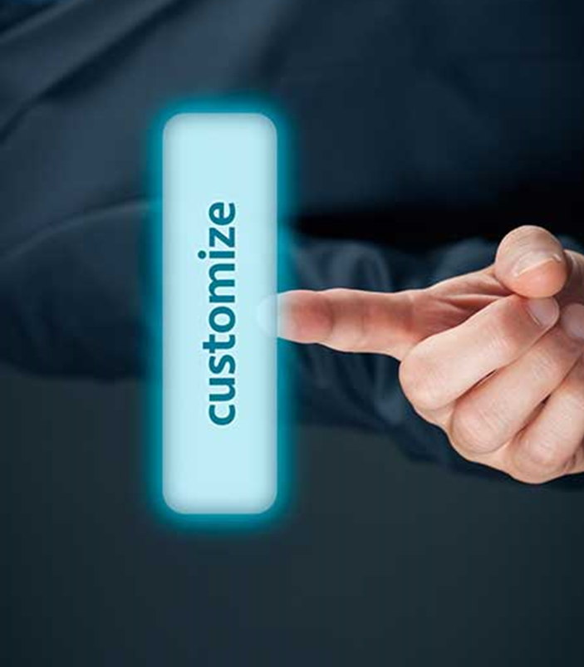


Collaboration Model
In our collaboration based model, we can work together with our partners in a number of ways
Collaboration based
Performance requirements
We need to properly understand requirements
Customised solutions
For new applications we can customise the solution
Supply chain and manufacturing
Different applications will require innovative approaches to manufacturing
Development Funding
We can work together to leverage different funding sources for development work

Slide 21
Thank you
Simon Savage, Managing Director
simons@ionicindustries.com.au
Mainak Majumder, Lead Researcher
mainak.majumder@monash.edu

